Slide 1


Name of Your Blue Ocean Business Idea
Your name (and your team)
Your high school
City / Country
Date

Slide 2
1
The Problem You Want to Solve
State clearly the problem you want to solve.
Be sure to highlight why this problem is important and how it impacts us.

Slide 3
2
Elevator Pitch for your Blue Ocean Idea
Describe in 2-3 sentences the essence of your blue ocean business idea.
Include a high-resolution image that is descriptive of your business.
Include a compelling tagline for your business comprising of 5-10 words that concisely articulate your blue ocean idea and also can be used for marketing it.

Slide 4
3
The Red Ocean Scenario
Use the As-Is Strategy Canvas tool to describe the red ocean scenario you are up against
Describe who are the major competitors in the market and what do they currently offer

Slide 5
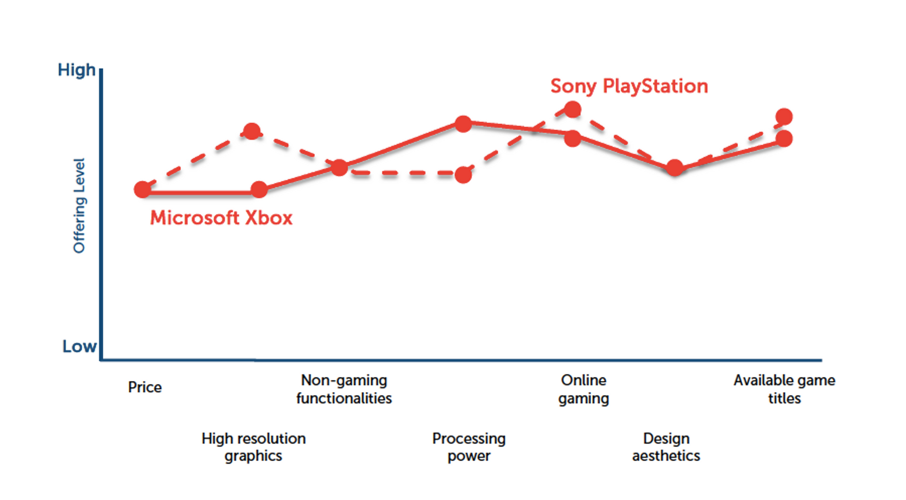
The Red Ocean Landscape: Video Gaming Industry 2006

Slide 6
4
Your Target Market
Use the Three Tiers of Noncustomers framework to describe the market that you plan to target.
Describe who are the customers that the industry players generally go after and if there are any groups of noncustomers that competitors seem to have ignored.
Describe how your target market is not a small niche but is potentially a huge blue ocean.

Slide 7
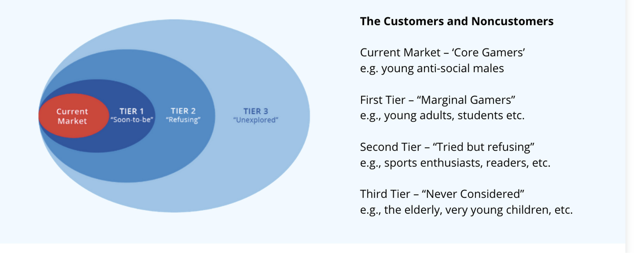
Example: The Market for Video Game Consoles

Slide 8
5
Your Blue Ocean Solution
Describe your blue ocean idea using the Eliminate-Reduce–Raise-Create (ERRC) Grid.
- What factors have you eliminated that the industry takes for granted?
- What factors have you reduced well below the industry standard?
- What factors have you raised well above the industry standards?
- What factors have you created that the industry never offered?
Use the To-Be Strategy Canvas to show your blue ocean solution stands apart from other industry players shown on the AS-IS Strategy Canvas.

Slide 9
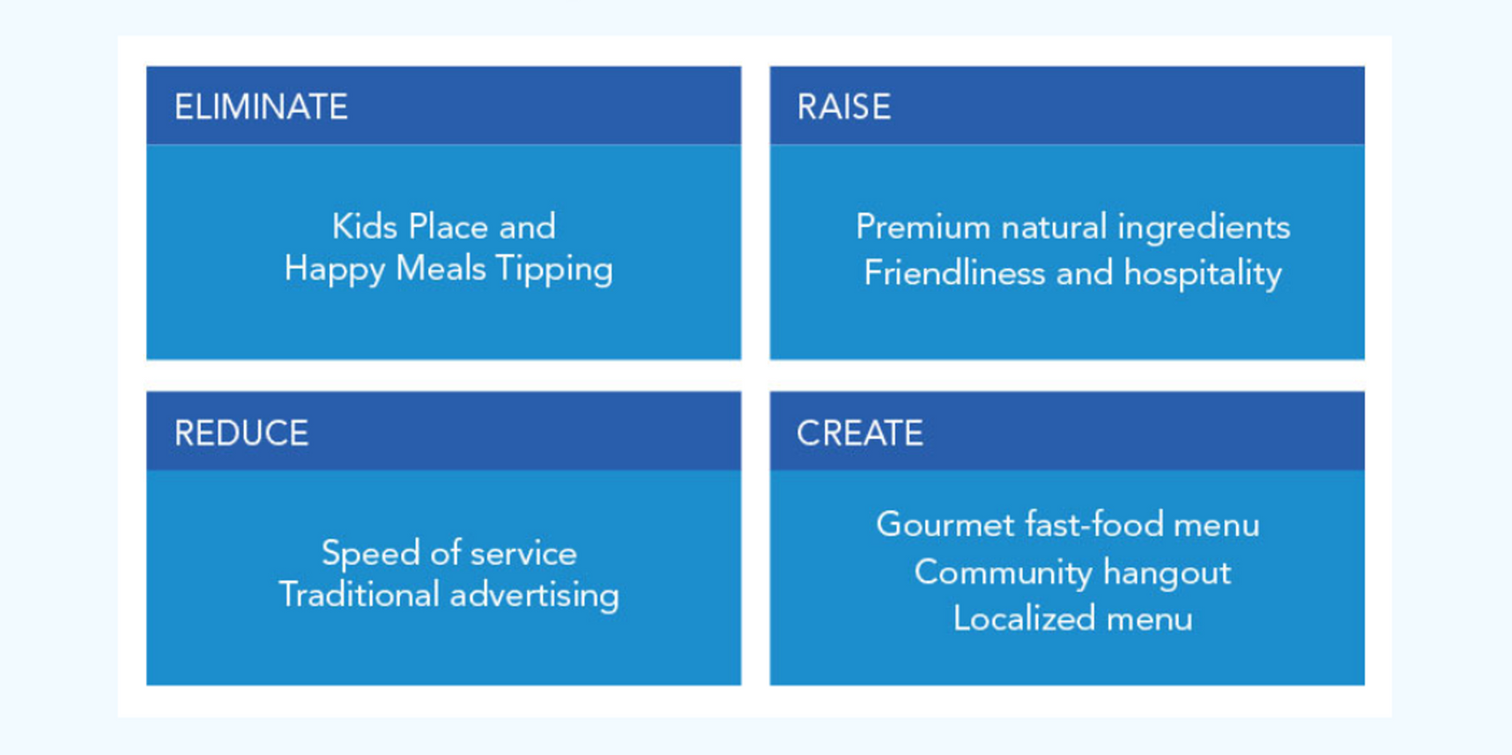
Example 2: Shake Shack

Slide 10
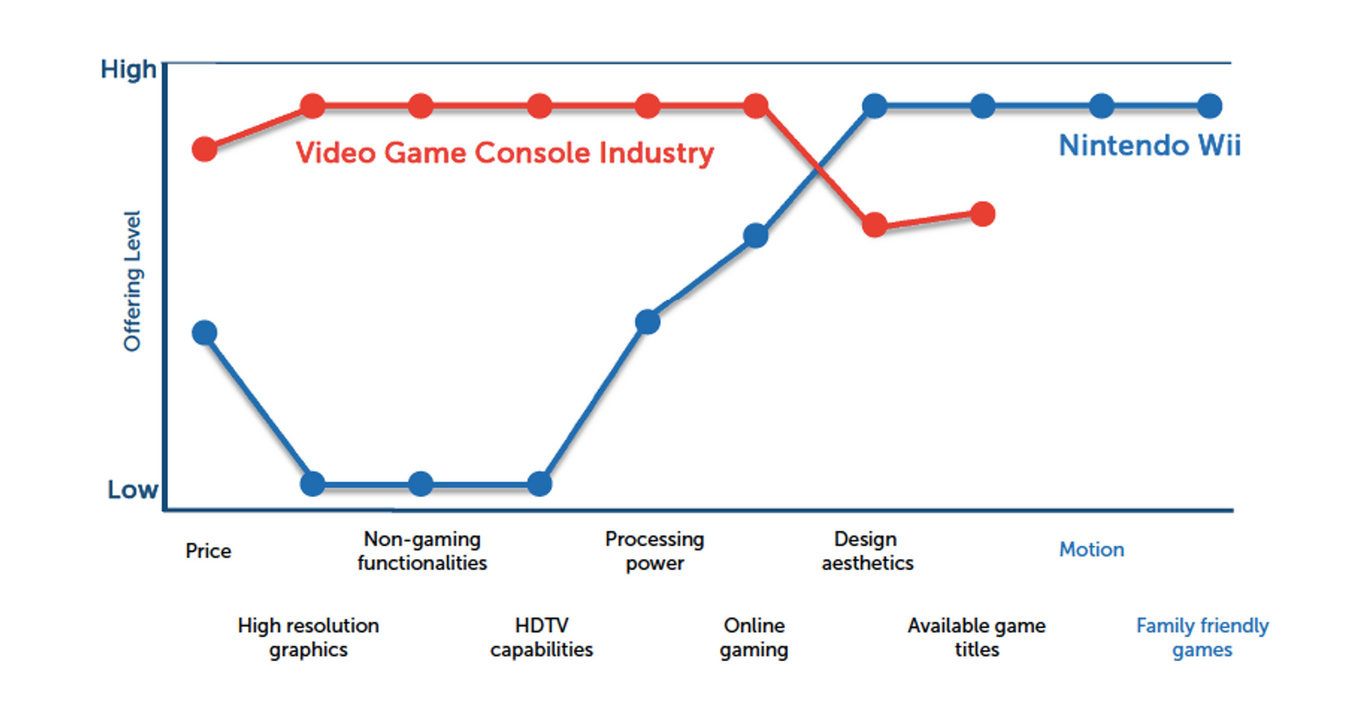
Nintendo Wii’s Blue Ocean Strategy

Slide 11
6
Your Results
Describe any milestones that you have achieved so far. For example:
- Is the product, prototype, or sample developed?
- Have first customers been acquired?
- Has a website been created?
- Have you lined up key partners and business advisors?
- Have you raised any money to fund the business?
- Have you filed for intellectual property, such as a patent?

Slide 12
7
The Numbers
Show that the money works. You don't need a five-year forecast.
- What does one unit cost you to make, or what does it cost to serve one customer?
- What will you charge, and why that price?
- How many people could you realistically reach in your first year?
- If you raised money, what would you spend it on first?

Slide 13
8
Wrap Up
Summarize your blue ocean business idea.
- Describe why your entrepreneurial idea is a blue ocean.
- How does it achieve differentiation and low cost simultaneously?
- Why will your business venture be successful?

Slide 14
Ready to pitch this?
Your slides are your plan. Recording yourself walking through them is your pitch.
The Blue Ocean Student Entrepreneur Competition is free and open to any high school student, anywhere in the world. Enter alone or with a team of up to five.
Register at blueoceancompetition.org/register

