Slide 1
EDIT THIS SLIDE
BLUE OCEAN
STUDENT ENTREPRENEUR COMPETITION
Free. Fully online. Open to every high school student in the world.
Presented by [YOUR NAME]
Blue Ocean Student Ambassador · [YOUR SCHOOL]
Notes:
SAY: Hi everyone, I'm [name], I'm in [grade/year], and I'm a Blue Ocean Student Ambassador for our school.
I've got about fifteen minutes to tell you about a competition you can enter for free, from your laptop, with an idea you haven't had yet.
TIMING: 30 seconds. Don't linger here.
BEFORE YOU PRESENT:
- Replace [YOUR NAME] and [YOUR SCHOOL] on this slide, the three prompts on slide 2, and your name and contact details on the last slide.
- Delete the yellow EDIT THIS SLIDE tags on slides 1, 2 and 21.
- Practise once out loud with a timer. The full deck runs about 15 minutes.

Slide 2
Why I signed up
EDIT THIS SLIDE
What made me say yes
What I've got out of it
Why I'm telling you
[Write one line. What caught your attention about this competition?]
[One line. A skill, a conversation, something you made, someone you met.]
[One line. Who in this room do you think should enter, and why?]
Keep it honest and keep it short. This is the slide that makes the rest of the deck believable.
Notes:
SAY: Your own three lines, in your own words.
This slide matters more than any other. Your classmates are not going to sign up because a competition exists. They will sign up because someone they know is doing it.
Don't read the boxes word for word. Say them the way you'd say them to a friend at lunch.
TIMING: 45 seconds.

Slide 3
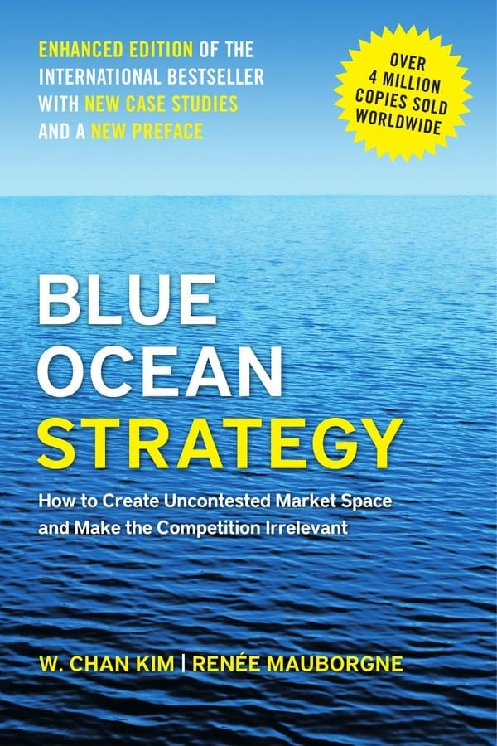
Where the idea comes from
The competition was inspired by the book Blue Ocean Strategy.
Written by W. Chan Kim and Renée Mauborgne, professors of strategy at INSEAD, one of the world's leading business schools.
The competition is supported by the authors and the Blue Ocean Strategy global brand.
Notes:
SAY: Everything I'm about to show you comes from this book.
Blue Ocean Strategy was written by W. Chan Kim and Renée Mauborgne. They're professors of strategy at INSEAD, one of the world's leading business schools.
The competition was inspired by the book, and it's supported by the authors and the Blue Ocean Strategy global brand. So the ideas you'll use in the competition are the same ones used by companies and organisations around the world.
POINT AT THE COVER. Some people in the room may have seen the book before.
TIMING: 30 seconds.

Slide 4
Two kinds of markets
Red oceans
Blue oceans
Every industry that exists today.
Industries that do not exist yet.
Crowded with competitors
Everyone offering roughly the same thing
You win only when somebody else loses
Shrinking room to grow
No competitors, because you created the space
Wide open room to grow
You win, your buyers win, your community wins
Waiting to be created. Possibly by you.
Notes:
SAY: The book describes two kinds of markets.
Red oceans are all the industries that exist today. Think of fifty energy drink brands fighting over the same shelf, all copying each other. To win, you have to take somebody else's share.
Blue oceans are industries that don't exist yet. Nobody competes there, because nobody has created that market space yet.
ASK THE ROOM: name an industry where everyone sells the same thing. Take two answers, no more. Getting one voice in the room early makes the rest of the talk easier.
TIMING: 1 minute.

Slide 5
You have a choice
Fight in a red ocean | Create a blue ocean
Strive to beat the competition | Make competition irrelevant
Capture share of existing markets | Create wide open new markets
Accept the rules of the game | Set new rules of the game
Find solutions to existing problems | Define and solve new problems
Serve customers of an industry | Bring noncustomers into an industry
Win at somebody else's expense | Create win-wins
Notes:
SAY: Same two ideas, put side by side.
The left column is what most businesses do, and it keeps most of them small.
The right column is the whole idea. Instead of asking how to beat everyone else, ask what you could build that makes that question pointless.
POINT AT ONE LINE: "Bring noncustomers into an industry." Everybody fights over the people who already buy. Almost nobody looks at the people who don't buy at all, and that is usually where new market space is waiting to be created.
TIMING: 45 seconds.

Slide 6
Blue Ocean Strategy empowers you…
1
2
Challenge the conventions
Create blue oceans systematically
…to challenge the conventions and create businesses that stand apart from the competition and create win-wins.
…to systematically create blue oceans using a set of tools and analytic frameworks that minimize your risks and maximize your opportunities.
Notes:
SAY: So what does blue ocean strategy actually give you?
Two things. First, permission to question how things are usually done, and to build something that stands apart and works out well for everyone involved.
Second, a method. Blue ocean strategy comes with tools and frameworks, so creating something new stops being a lucky guess. We'll look at two of those tools in a minute.
TIMING: 30 seconds. Keep it moving, this slide sets up the next few.

Slide 7
Why is Blue Ocean Strategy critical for you?
Creative new solutions are required in almost every industry
1
Think healthcare, education (K-12, university, community colleges), the environment, finance, cyber security, energy, our food chain. All are in dire need of creative solutions.
Most students can't get a job when they graduate
2
More than 4 out of 5 students graduate from college without a job. Youth unemployment is three times higher than adult unemployment.
Blue Ocean Strategy empowers you to fuel growth and create jobs
3
75% of new jobs in our economy are created by entrepreneurs every year. Blue Ocean Strategy empowers entrepreneurs to systematically solve new and pressing problems and create new jobs.
Notes:
SAY: Why should any of this matter to you right now, in high school?
Almost every area you can think of needs new ideas. Healthcare, education, the environment, energy, the food we eat. None of these are finished.
Jobs matter too. A lot of new jobs come from people who start something of their own, and this is a way to practise that early.
KEEP IT PERSONAL: ask yourself which of these areas you care about most, and mention it in one sentence. It lands better than reading the list.
TIMING: 45 seconds.

Slide 8
What's the central message?
Create. Don't compete.
Value innovate
Do not aim to beat the competition. Make it irrelevant. Create a bigger pie rather than fighting for a slice of an existing pie.
Be sure to link innovation to value. Unless tied to a leap in value for buyers, new and novel technology is not enough to create a blue ocean and make the competition irrelevant.
Notes:
SAY: There are four big ideas behind blue ocean strategy. Here are the first two.
Create, don't compete. Stop fighting for a slice of the pie that already exists and make a bigger pie.
Value innovation. This is the one people get wrong. A new app or a clever piece of technology is not enough on its own. It only creates a blue ocean when it gives buyers a real leap in value.
TIMING: 45 seconds.

Slide 9
What's the central message?
Create win-wins.
Not win-lose.
Minimize risks while maximizing opportunities
Your win no longer has to come at somebody else's loss. Create businesses that make you win, make your buyers win and make your community win as well.
Creativity and entrepreneurship are often random and risky. Blue Ocean Strategy uses tools and frameworks that minimize risks and maximize opportunities as you create a new business.
Notes:
SAY: And the other two.
Create win-wins. Your success doesn't have to come at someone else's expense. The best ideas work for you, for the people who buy from you, and for your community.
Minimise risk while maximising opportunity. Starting something new usually feels random and risky. Blue ocean strategy gives you a step-by-step way to think it through, so you're making decisions on purpose.
TIMING: 45 seconds.

Slide 10
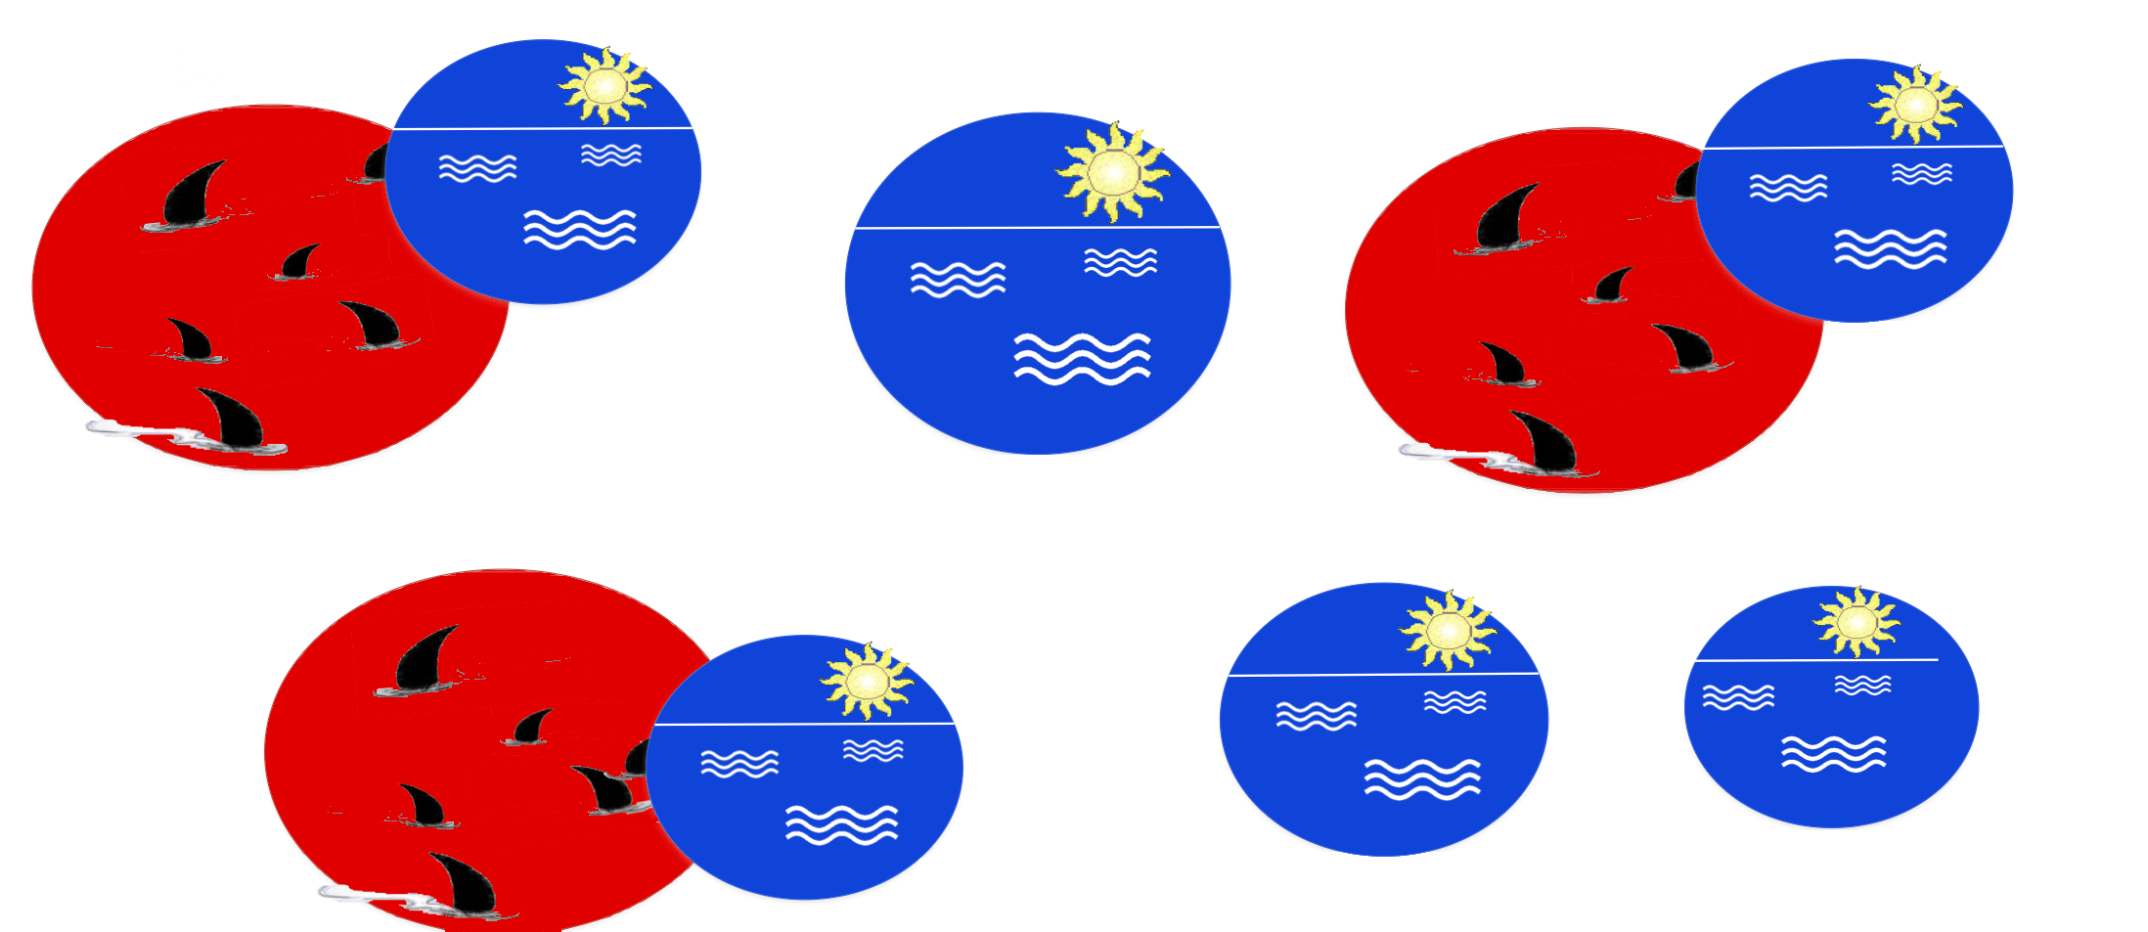
What are some examples of Blue Ocean Strategy?
Taxis
Circus industry
Uber
Cirque du Soleil
YouTube
Encyclopedia industry
Wikipedia
Dry Bar
Rent the Runway
Notes:
SAY: You already use blue oceans without thinking about it.
Taxis were a crowded red ocean. Uber created a new way to get a ride.
The circus industry was shrinking. Cirque du Soleil created a new kind of live show that drew in adults who never went to the circus.
Encyclopedias were expensive books. Wikipedia made knowledge free and open to everyone.
And some companies created a whole new space from the start: YouTube, Dry Bar, Rent the Runway.
ASK THE ROOM: which one of these do you use? A show of hands is enough.
TIMING: 1 minute.

Slide 11
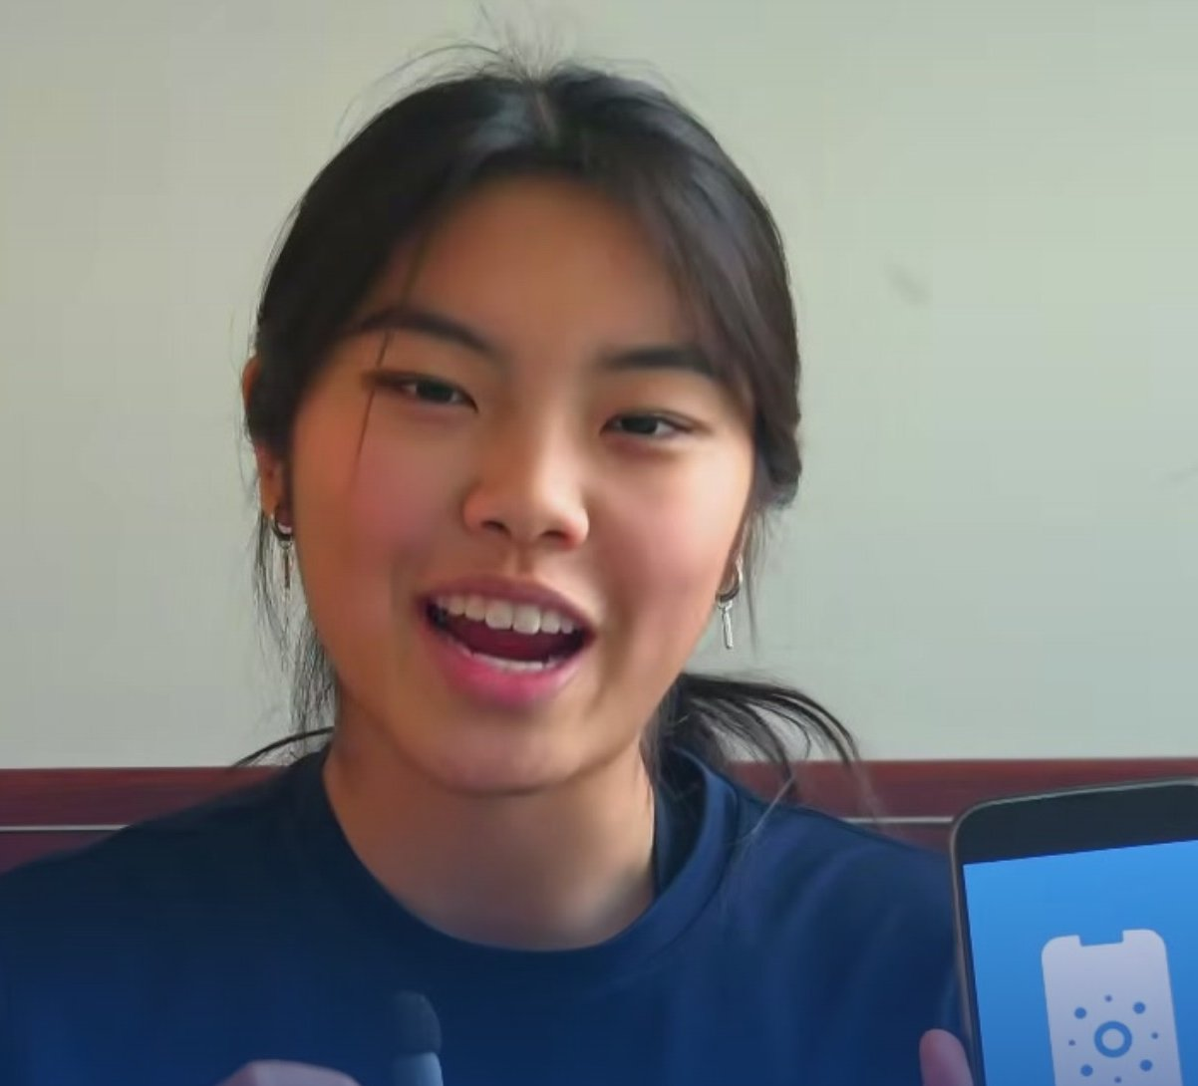
Angie and Alex, high school juniors
Global 1st runner-up, 2026 · Carmel High School, USA
THE RED OCEAN
Skin cancer screening apps all competed on the same things. Price. Features. Speed.
WHAT THEY SAW
Those apps reached up to 85% accuracy on light skin. On dark skin it fell to around 60%. Nobody had entered that space.
WHAT THEY CREATED
Dermi. A screening platform corrected for that bias, trained on over 80,000 clinical images across light, medium and dark skin.
They created their blue ocean by asking who the industry was serving badly.
Notes:
SAY: Here is what that looks like when students do it.
Angie and Alex were high school juniors. They looked at skin cancer screening apps, which all compete on price, features and speed. Then they noticed something none of those apps had dealt with: accuracy dropped sharply on darker skin.
That was their uncontested market space. They built Dermi around it.
MAKE THIS POINT: they didn't invent a new technology from nothing. They asked who the whole industry was serving badly, and built for those people. Anybody in this room could make that move.
TIMING: 1 minute.

Slide 12
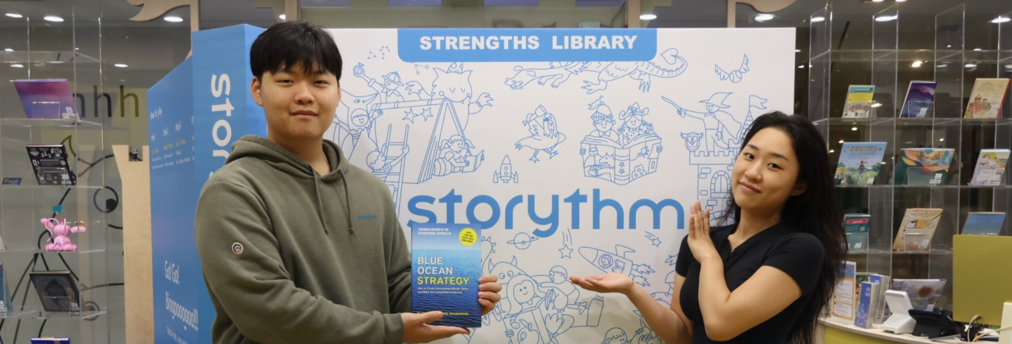

And two more from the same year
Storythm
Accumulus
Global winner, 2026 · Chadwick International, South Korea
Global 2nd runner-up, 2026 · Bellarmine College Preparatory, USA
Taeyang started from a question about why children stop enjoying reading around age nine. The reading market was fixated on test scores. Storythm was built to bring back the reading itself.
Arnav's team went after concrete. Repair methods only react after cracks appear. They built an additive that heals cracks on its own, and measured 70% crack closure over four weeks.
Reading. Concrete. Skin cancer. No two of these are in the same industry.
Notes:
SAY: Same year, two more.
Storythm came out of South Korea, from a question about why kids stop enjoying reading. Accumulus came from a team looking at cracked concrete.
MAKE THIS POINT: reading, concrete, skin cancer. They have nothing in common. You don't need a tech idea and you don't need to code. You need a problem you actually care about and a fresh way of looking at it.
If you have time and a screen, play thirty seconds of one of these pitches. They're on the competition's YouTube channel.
TIMING: 45 seconds.

Slide 13
So what is the competition?
The largest and most prestigious virtual pitch competition for high school students around the world.
23,000+
9,000+
173
50
students in 2026
schools
countries
US states
Free to enter. There is no cost at any stage.
Fully online. There is no live event and no travel.
Open to any high school student aged 14 to 18, anywhere in the world.
Enter alone, or as a team of up to five.
Every student who submits receives a certificate. Cash prizes for top finishers.
Notes:
SAY: So, the competition. In 2026, more than 23,000 students entered, from over 9,000 schools, across 173 countries and all 50 US states.
Hit the word FREE hard. Cost is the first worry in every room and the easiest one to remove.
Also hit "fully online". Nobody is asking you to travel anywhere or stand on a stage.
IF SOMEONE ASKS ABOUT PRIZES: point them to the website, where the current prizes are listed.
TIMING: 45 seconds.

Slide 14



Who are the major sponsors behind the competition?
Notes:
SAY: The competition is backed by some serious names.
Harvard Business Review is one of the best-known business magazines in the world, read by managers and leaders everywhere.
INSEAD is one of the world's leading business schools, with campuses in Europe, Asia and the Middle East. It's where the two authors of Blue Ocean Strategy, W. Chan Kim and Renée Mauborgne, teach as professors of strategy.
General Atlantic is a global investment firm that backs fast-growing companies around the world.
KEEP IT SHORT: one sentence per logo is plenty. The point is that this is a real competition that people outside school take seriously, and it looks good on an application.
TIMING: 40 seconds.

Slide 15
How it works
1
Register
Free, on the website. Takes a couple of minutes.
2
Take the Blue Ocean Mini-Course
Free, under 35 minutes, and you get a certificate. Required before you submit.
3
Find a problem worth solving
Something broken, ignored, or badly served. Anywhere, any industry.
4
Build your blue ocean idea
Use the tools from the course to shape it.
5
Record a 5-minute video and submit
Filmed on a phone is completely fine. Judges take it from there.
Notes:
SAY: Five steps, start to finish.
Register. Take the Blue Ocean Mini-Course, which is free, takes under 35 minutes and gives you a certificate you can put on an application. Pick a problem worth solving. Build your idea using the tools from the course. Record a five-minute video and submit it.
SAY THIS OUT LOUD: a phone is fine. People assume they need equipment they don't have, and they don't.
Tell them to do the Mini-Course early, in the first week, rather than the week of the deadline. It makes the rest much easier.
TIMING: 45 seconds.

Slide 16
Dates to put in your phone
5 April 2027
Top 100 announced
21 February 2027
22 April 2027
Top 30 announced
Submission deadline. This is the one that matters.
4 May 2027
Top 10 announced
Register today, submit any time before 21 February.
13 May 2027
Winners announced
Notes:
SAY: There's one date to remember, and it's 21 February.
Everything after that is the competition announcing results, so you don't need to hold those dates in your head.
TELL THEM TO GET THEIR PHONES OUT AND SET A REMINDER NOW. It sounds small, but it's the single most effective thing you can do in the room, and much easier than asking people to register while you're still talking.
TIMING: 30 seconds.

Slide 17
What are some Blue Ocean Strategy tools?
Strategy Canvas
ERRC Grid
High
Blue Ocean Strategic Move
Eliminate
Raise
What factors will you eliminate that the industry takes for granted?
What factors will you raise well above the industry standard?
Offering level
A New Value Curve
Industry Value Curve
Reduce
Create
Low
What factors will you reduce well below the industry standard?
Which factors will you create that the industry has never offered?
Competing factors
Notes:
SAY: Remember I said blue ocean strategy comes with tools? These are two of them, and you'll learn both in the Mini-Course.
On the left is the Strategy Canvas. Along the bottom are the things an industry competes on. The red line shows what everyone in the industry offers. The blue line shows a company that broke away and drew a very different value curve.
On the right is the ERRC Grid. It asks four questions. Which factors that the industry takes for granted can you eliminate? Which can you reduce well below the industry standard? Which can you raise well above it? And what can you create that the industry has never offered? Your answers give you a new value curve, which is the start of a blue ocean.
DON'T TEACH THE WHOLE THING: you only need them to see that there's a method. The course does the teaching.
TIMING: 1 minute.

Slide 18
Participating is easy
Any high school student from around the world can register for the competition individually or team up with up to four friends to compete together.
1
They first learn the blue ocean concepts by completing a free Blue Ocean Mini-Course and upon completing they gain a valuable certificate.
2
They identify a pressing problem the world faces or a new market space that no one has tapped into.
3
To address this, they create a blue ocean solution and build a business idea around it.
4
The students then record a 5-minute video and submit it. A panel of experienced judges selects the winners.
5
Notes:
SAY: Just to pull it all together, here's the whole journey in one place.
Anyone in high school, anywhere in the world, can enter alone or with up to four friends. You learn the concepts in the free Mini-Course, pick a problem, create a blue ocean solution, record five minutes of video, and a panel of experienced judges takes it from there.
If you covered slide 15 in detail, keep this one quick or skip it.
TIMING: 30 seconds.

Slide 19
Questions people ask me
Do I need a business idea already?
Do I need a team?
No. Most people register first and work the idea out afterward. The course walks you through finding one.
No. You can enter alone or with up to four other people.
Does it cost anything?
What if my English isn't strong?
No. Registration, the course and the certificate are all free.
Students from 173 countries entered last year. Say your idea clearly, that is what counts.
Do I need to code or build a product?
How much work is it, honestly?
No. You are pitching an idea, not shipping a company.
The course is under 35 minutes. After that it's the thinking, plus a five-minute video.
Notes:
SAY: These are the six questions I get every time, so let me answer them before you ask.
Go through them fast. Don't read every word, just give the answer.
IF SOMEBODY ASKS SOMETHING YOU DON'T KNOW: say you'll find out and get back to them, then actually do it. Guessing is worse than not knowing, and it's how wrong information spreads.
TIMING: 45 seconds.

Slide 20
You can create a BLUE OCEAN…
Start looking at the world with a new perspective
See possibilities where others see boundaries
1
2
See growth where others see red oceans
Solve problems that have never been solved before
3
4
Create solutions that will change our lives
Make this world a better place for all of us!
5
6
Notes:
SAY: This is really what it comes down to.
Read the six lines slowly, or pick the two that mean the most to you and say why. Pause after the last one before you move on.
This is the emotional close. Say it like you mean it, then go straight to the next slide.
TIMING: 30 seconds.

Slide 21

EDIT THIS SLIDE
Register today
blueoceancompetition.org
Come and find me if you want help getting started.
[YOUR NAME] · [YOUR EMAIL OR SOCIAL HANDLE]
Scan to register
The next blue ocean is yours to create.
Notes:
SAY: That's it. Registration is free and takes a couple of minutes. The next blue ocean is yours to create.
LEAVE THIS SLIDE UP while people file out. It does more work sitting on the screen than anything you say over the top of it.
BEFORE YOU PRESENT: add your name and a way to reach you, then delete the EDIT THIS SLIDE tag. The QR code is already on the slide and takes people straight to the registration page.
ASK EVERYONE WHO REGISTERS to enter your name in the 'referred by an ambassador' field on the registration form. That's how your referrals are counted.
TWO THINGS THAT DECIDE WHETHER THIS WORKED:
1. Ask people to set the 21 February reminder while you're still standing there.
2. Get a way to follow up. A sign-up sheet by the door, a group chat, or simply "message me and I'll send you the link".
Log this talk in your activity log the same day, while you still remember how many people were in the room. Speaking to a classroom earns Ambassador Points.
TIMING: 30 seconds, then take questions.

